Slide 1
dATA ANALYSIS PROJCET
TEAM MEMBERS:
HOSSEIN FAGHIHI
AMIRHOSSEIN RANJBAR

Slide 2
Data descreption
The data is from the [Tennis Database]. The data contains information about the players, their matches, and the matches they played in. The data was in the form of a zip file. The zip file contains 31 zipfiles that contains parquet files for each table in the database. Each parquet file contains the data for a single table for just one day.

Slide 3
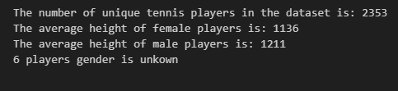
1. How many tennis players are included in the dataset?

Slide 4
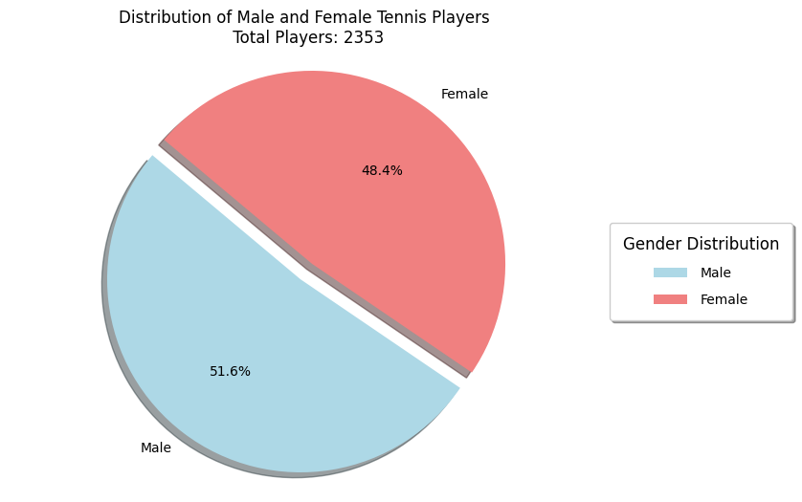

Slide 5

2.What is the average height of the players?

Slide 6
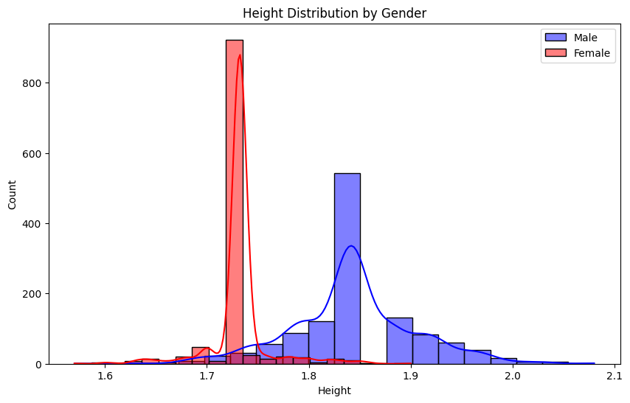

Slide 7



3.1.Which player has the highest number of wins?
Juszczak P
Darderi L

Slide 8

3.2.Which player has the highest number of wins?

Slide 9
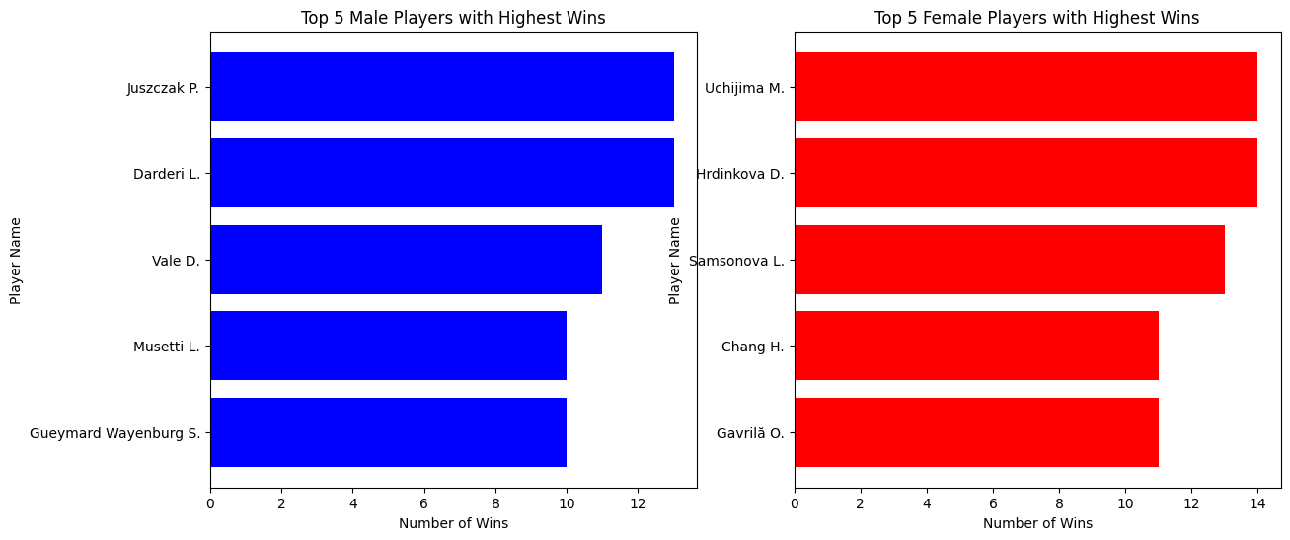

Slide 10
4.What is the longest match recorded in terms of duration?

Slide 11

5.How many sets are typically played in a tennis match?

Slide 12
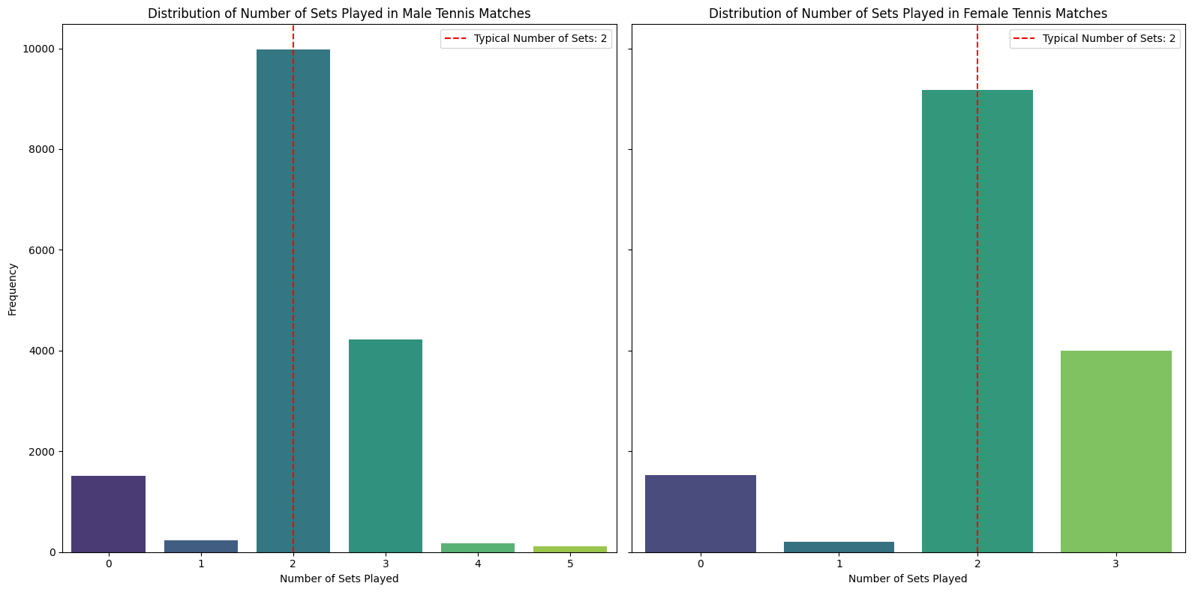

Slide 13
6.Which country has produced the most successful tennis players?

Slide 14
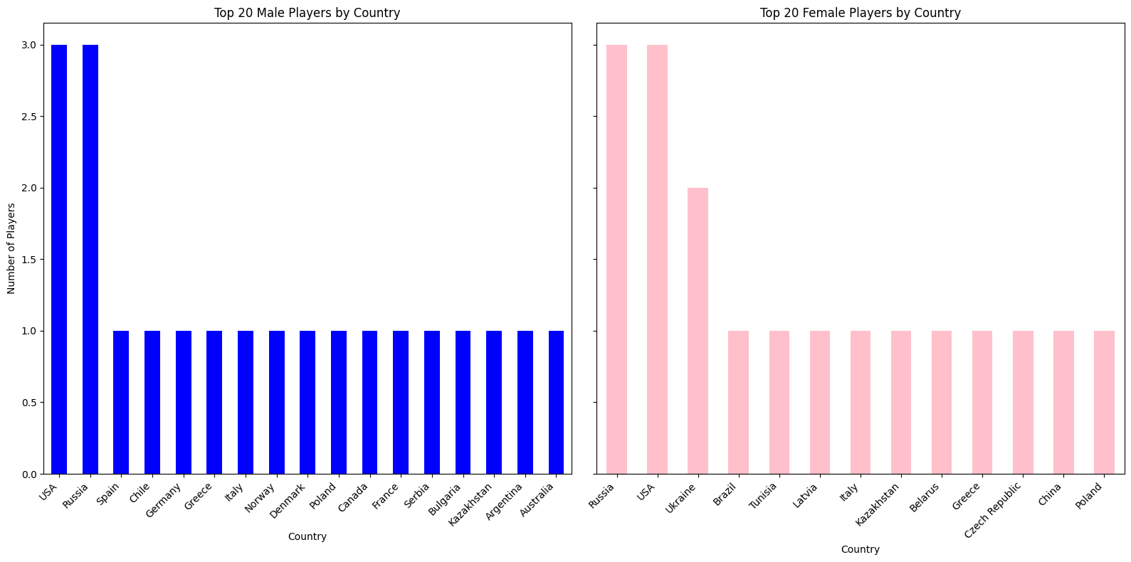

Slide 15

7.What is the average number of aces per match?

Slide 16
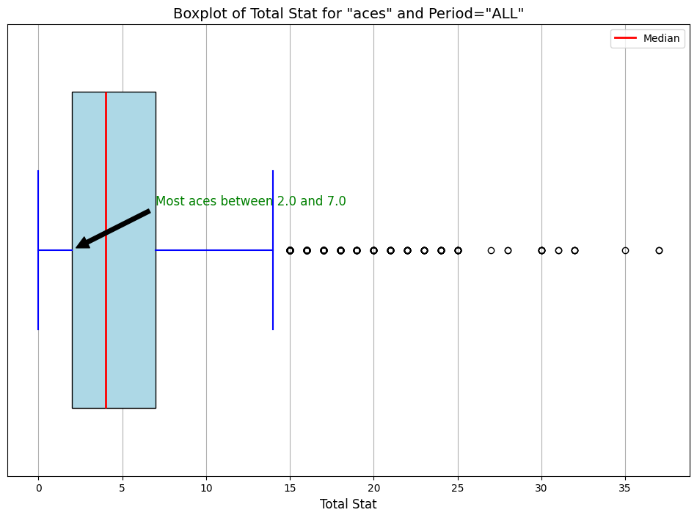

Slide 17
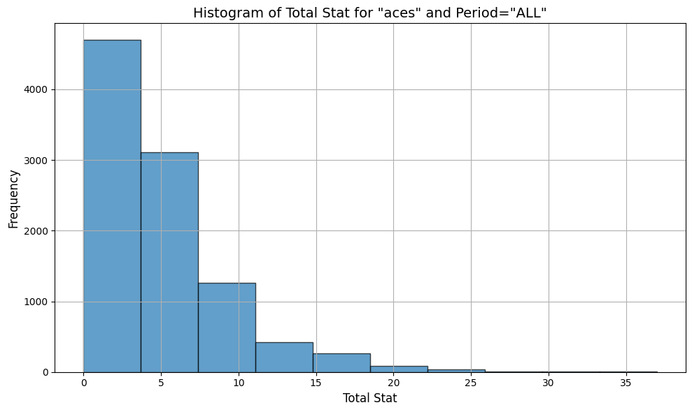

Slide 18

8.Is there a difference in the number of double faults based on gender?

Slide 19
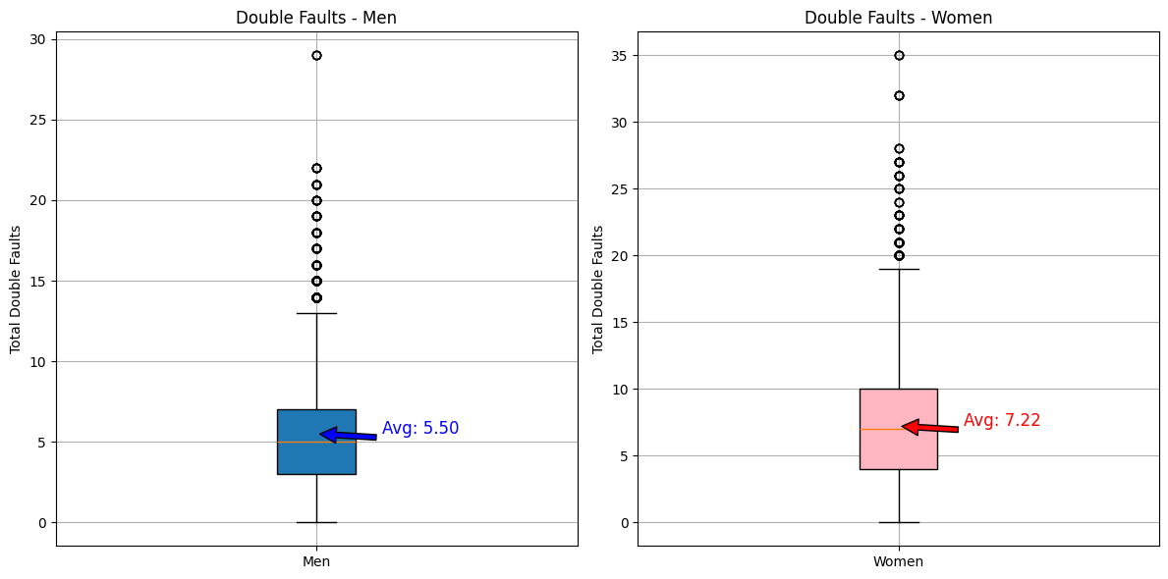

Slide 20

9.Which player has won the most tournaments in a single month?

Slide 21
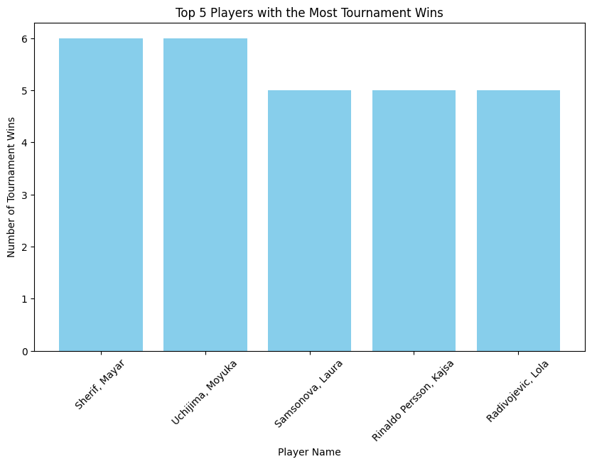

Slide 22
10.Is there a correlation between a player's height and their ranking?

Slide 23
11.What is the average duration of matches?

Slide 24
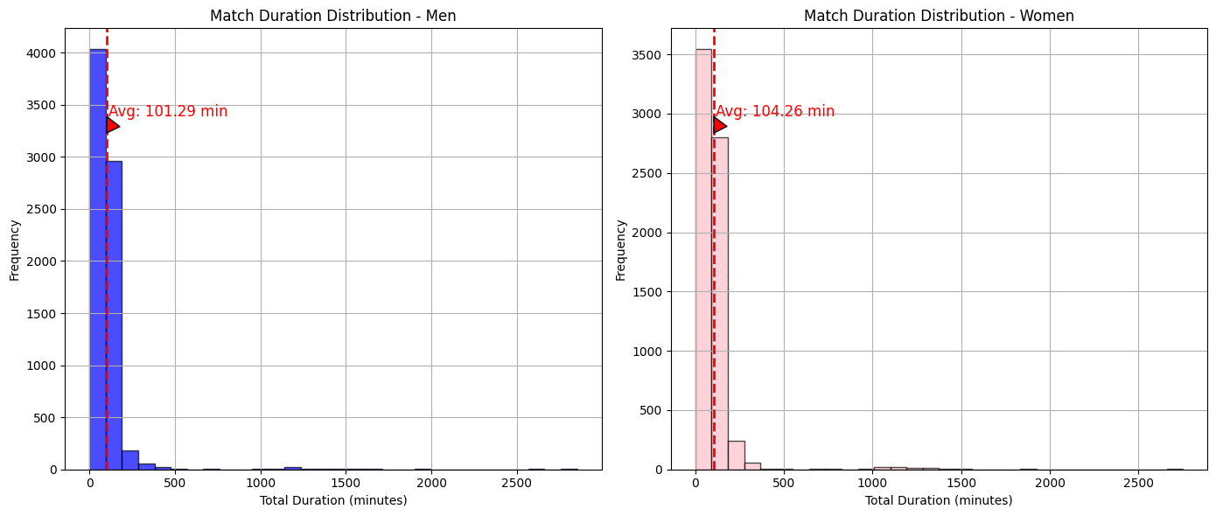

Slide 25

12-What is the average number of games per set in men's matches compared to women's matches?

Slide 26
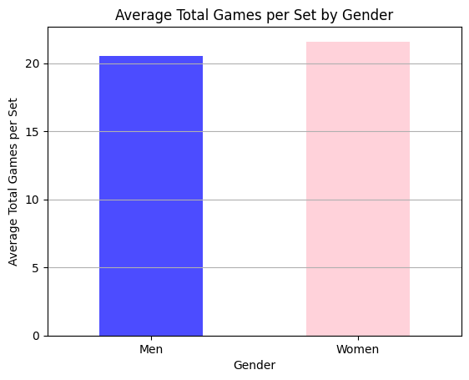

Slide 27
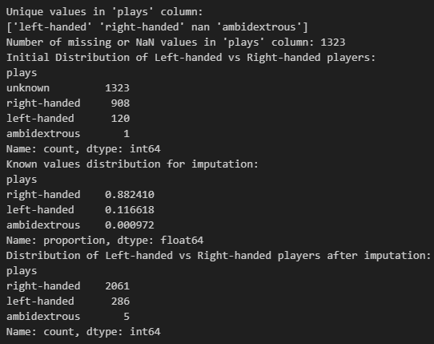
13.What is the distribution of left-handed versus right-handed players?

Slide 28
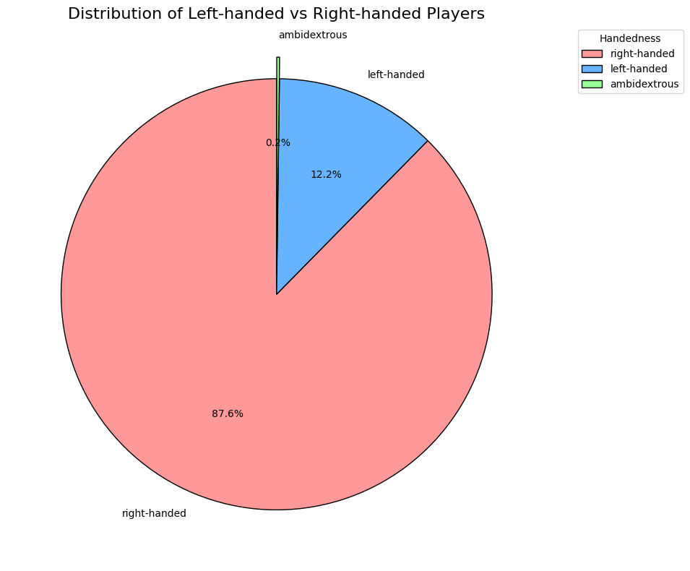

Slide 29
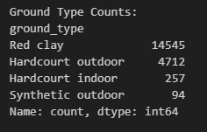

14.What is the most common type of surface used in tournaments?

Slide 30
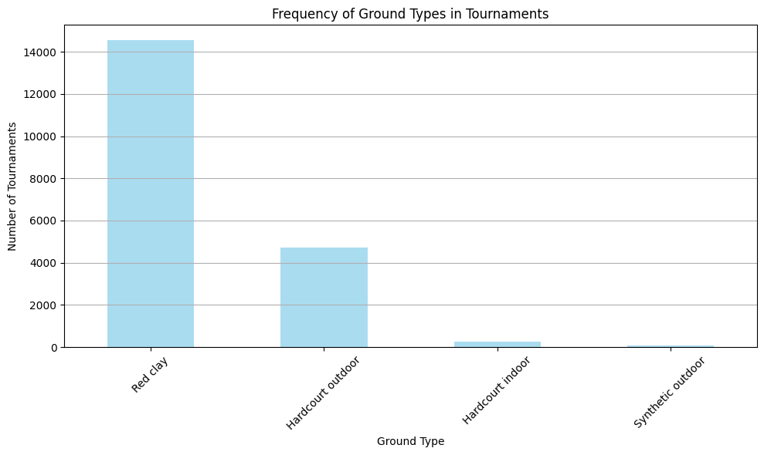

Slide 31
15.How many distinct countries are represented in the dataset?

Slide 32

16.Which player has the highest winning percentage against top 10 ranked opponents?

Slide 33

17.What is the average number of breaks of serve per match?

Slide 34
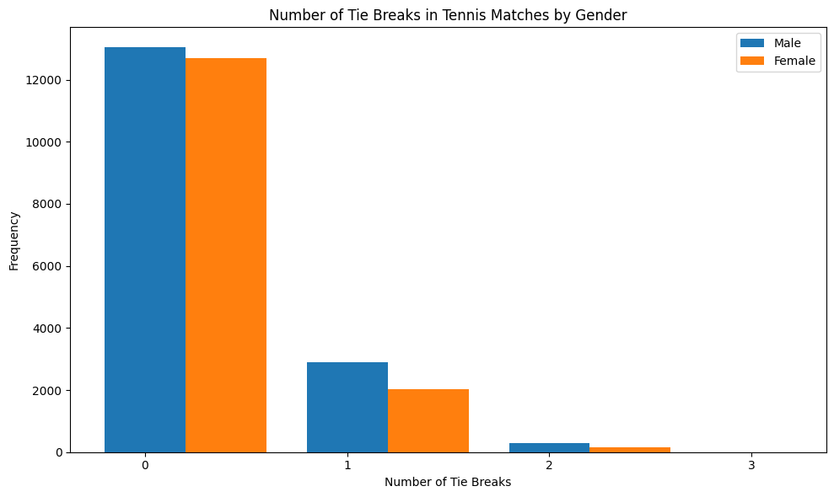

Slide 35
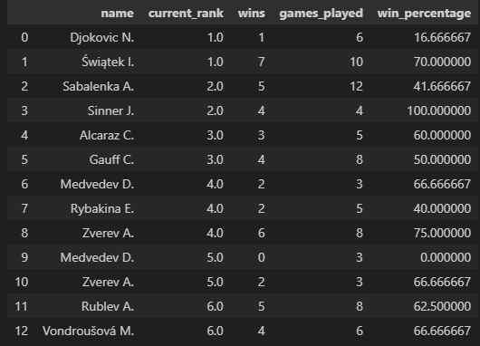
18.What is Percentage of wins among the top 25 ranked players?

Slide 36
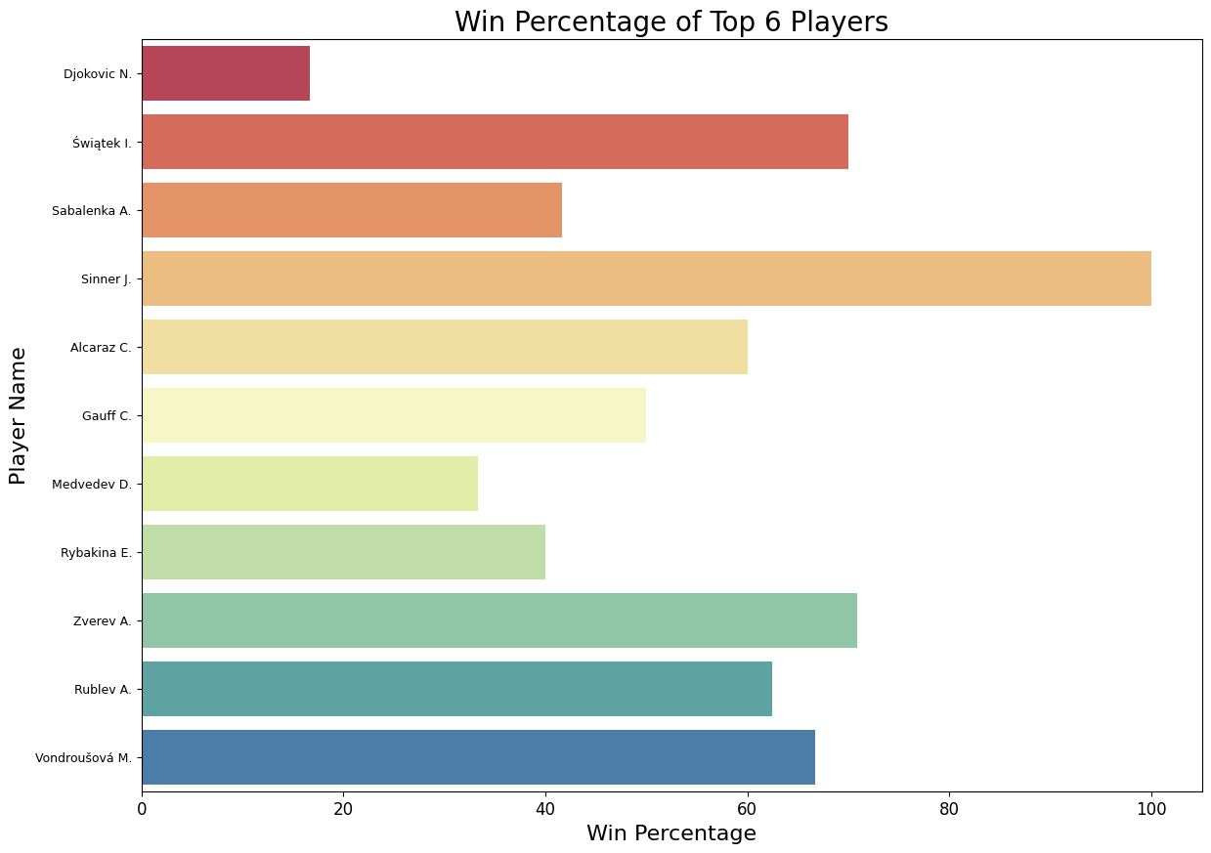

Slide 37
19.Who wins the final game in each tournaments?

Slide 38
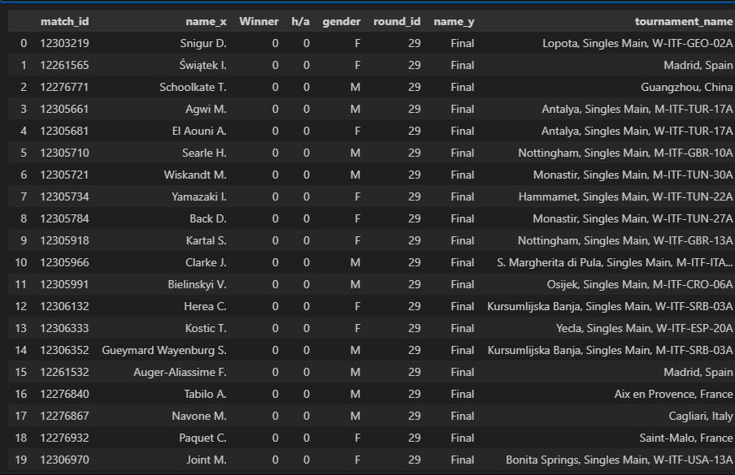

Slide 39
20.top 20 players with most tournament participation

Slide 40
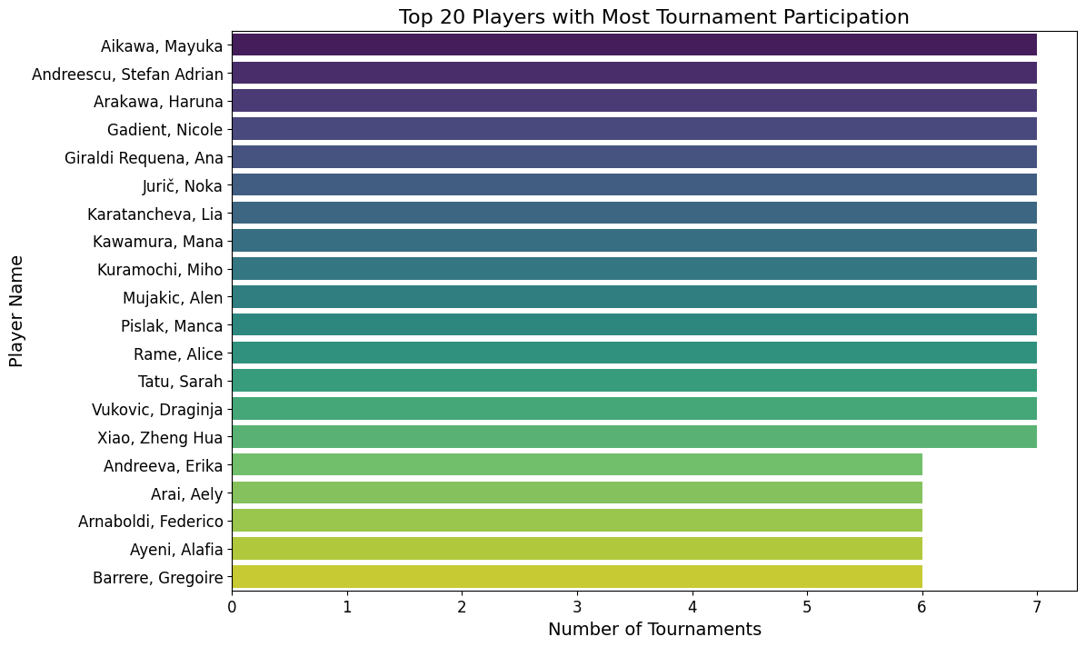

Slide 41

21.What is the average weight of the players?

Slide 42
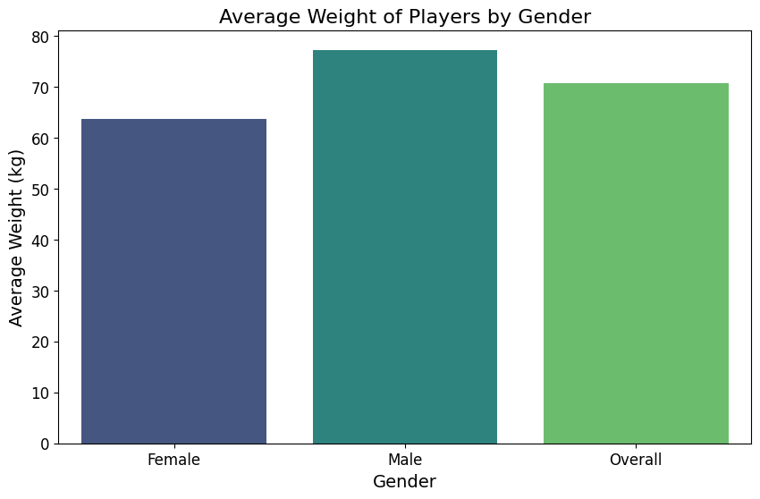

Slide 43
22.find top 10 players with most aces points in this month

Slide 44
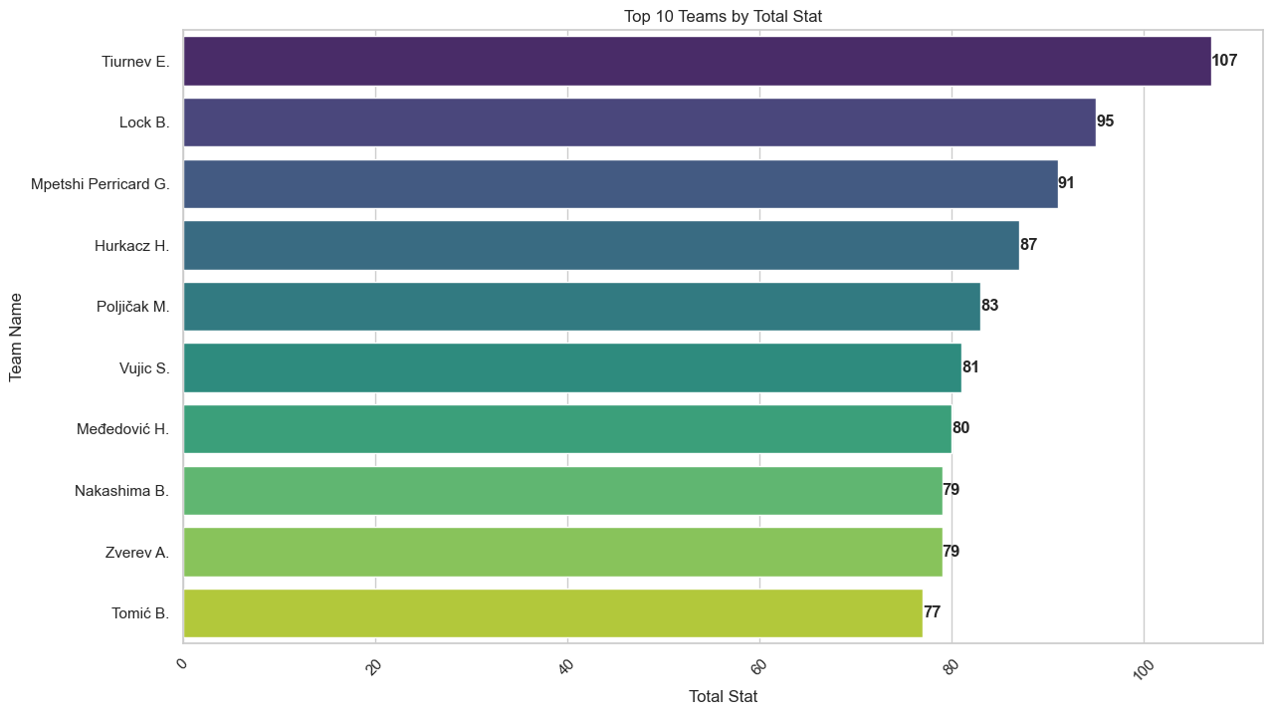

Slide 45
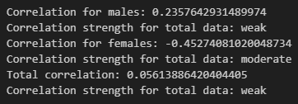
23.What is the correlation between those whose rank is among the top 10 and the number of their aces?

Slide 46

24.Which country hosted the most games and how many games?

Slide 47
25.What has been the win percentage of players who played in their own country and had more than 10 matches played?

Slide 48
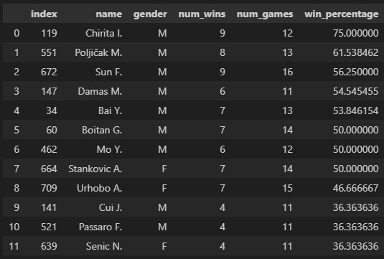

Slide 49
Thanks for your time

